Slide 1
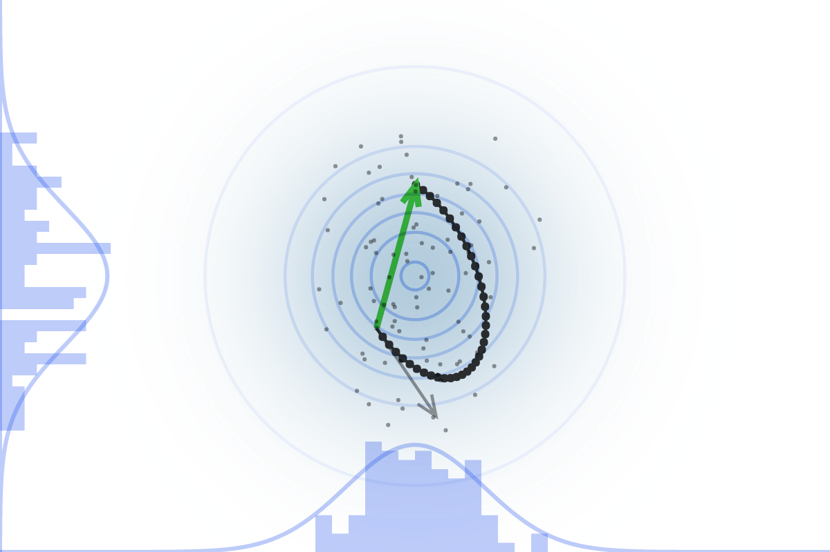
Markov Chain Monte Carlo
Mike Slawinski
March 22, 2018

Slide 2
Agenda
Motivation – why do we need to sample?
MCMC Example – Metropolis Hastings
Measure in High Dimensional Space
Hamiltonian Monte Carlo

Slide 3
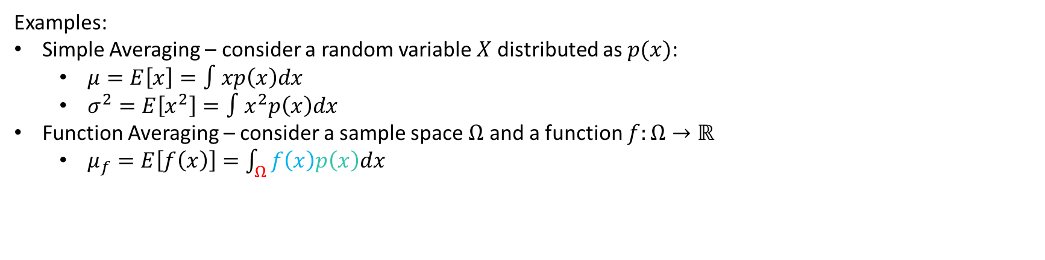
Motivation
In order to do statistics, we must integrate.
Examples:
Simple Averaging – consider a random variable $X$ distributed as $p(x)$:
$μ=E\left[x\right]=∫xp\left(x\right)dx$
$σ^{2}=E\left[x^{2}\right]=∫x^{2}p\left(x\right)dx$
Function Averaging – consider a sample space $Ω$ and a function $f:Ω→ℝ$
$μ_{f}=E\left[f\left(x\right)\right]=\int_{Ω}{f\left(x\right)p\left(x\right)dx}$
Less Likely
More Likely

Slide 4
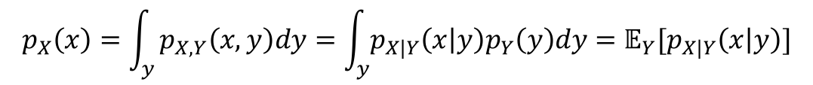
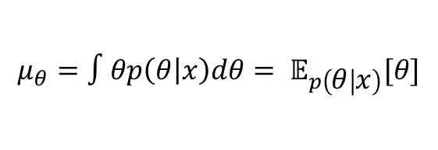
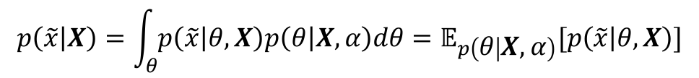
Motivation – Bayesian Modeling
Understand models by understanding the distributions of the model parameters
Compute the mean of the posterior
$$μ_{θ}=∫θp\left(θ | x\right)dθ= 𝔼_{p\left(θ | x\right)}[θ]$$
Compute the posterior predictive distribution
$$p\left(\tilde{x} | X\right)=\int_{θ}{p\left(\tilde{x} | θ,X\right)p\left(θ | X,α\right)dθ}=𝔼_{p\left(θ | X,α\right)}[p\left(\tilde{x} | θ,X\right)]$$
Compute marginalization
$$p_{X}\left(x\right)=\int_{y}{p_{X,Y}\left(x,y\right)dy=\int_{y}{p_{X|Y}\left(x | y\right)p_{Y}\left(y\right)dy=𝔼_{Y}[p_{X|Y}\left(x | y\right)]}}$$

Slide 5
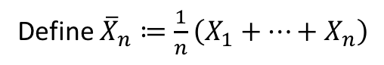
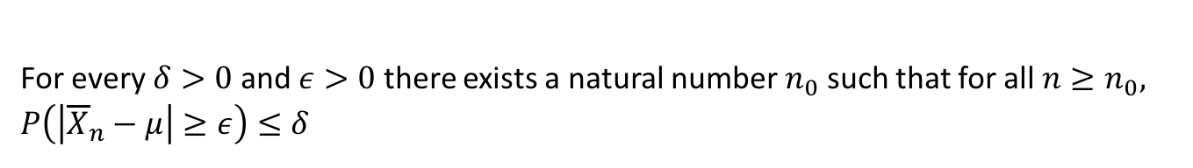
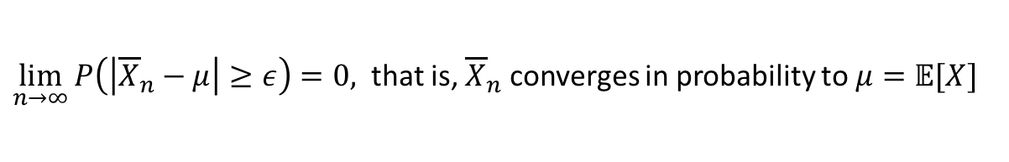
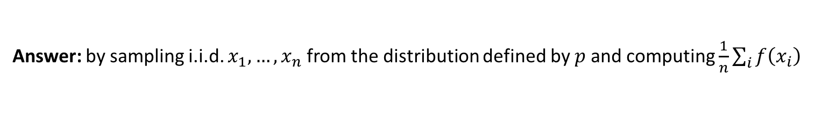
Integration via Sampling
Question: How do we integrate?
Answer: Law of Large Numbers
Suppose $X_{1}, . . . , X_{n}$ is a sequence of i.i.d. random variables with mean $𝔼[X_{i}]=μ$
Define ${\overline{X}}_{n}≔\frac{1}{n}\left(X_{1}+…+X_{n}\right)$
For every $δ>0$and $ε>0$ there exists a natural number $n_{0}$ such that for all $n≥n_{0},$
$P\left(\left|{\overline{X}}_{n}−μ\right|≥ε\right)≤δ$
In other words,
$\lim_{n→∞}{P\left(\left|{\overline{X}}_{n}−μ\right|≥ε\right)=0, }$ that is, ${\overline{X}}_{n}$ converges in probability to $μ=𝔼[X]$
Question: How compute $𝔼_{p}[f]=∫f\left(x\right)dp\left(x\right)=∫f\left(x\right)p\left(x\right)dx$ ?
Answer: by sampling i.i.d. $x_{1},…,x_{n}$ from the distribution defined by $p$ and computing $\frac{1}{n}\sum_{i}{f\left(x_{i}\right)}$

Slide 6
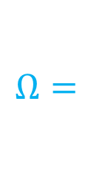

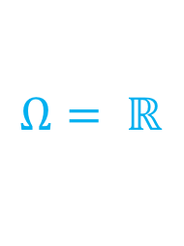
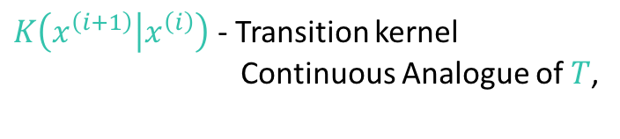
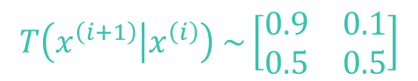
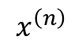
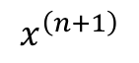
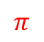
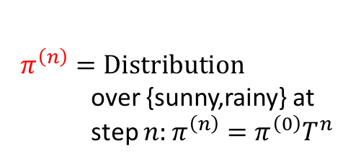

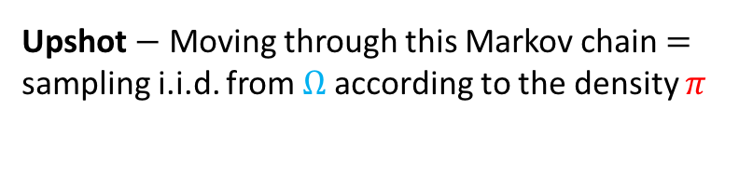
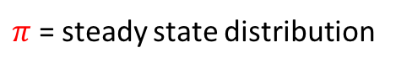
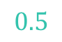
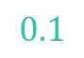
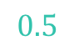
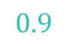
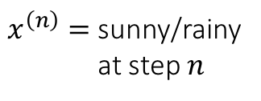
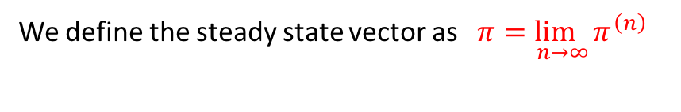
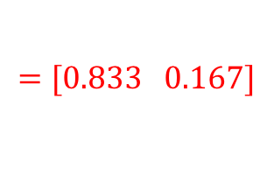
Markov Chain Monte Carlo – Discrete vs Cont.
Markov Chain:
$$0.1$$
$$π$$
$$0.9$$
sunny
rainy
$$0.5$$
$$x^{\left(n\right)}$$
$$x^{\left(n+1\right)}$$
$$0.5$$
$$Ω= ℝ$$
$$Ω=$$
sunny
rainy
$x^{\left(n\right)}=$ sunny/rainy
at step $n$
$K\left(x^{\left(i+1\right)} | x^{\left(i\right)}\right)$ - Transition kernel
Continuous Analogue of $T$,
$$T\left(x^{\left(i+1\right)} | x^{\left(i\right)}\right) \sim \left[\begin{matrix}0.9 & 0.1 \\ 0.5 & 0.5\end{matrix}\right]$$
$$π^{\left(n\right)}=Distribution$$
over {sunny,rainy} at
step $n:π^{\left(n\right)}=π^{\left(0\right)}T^{n}$
$π$ = steady state distribution
proportional to target distribution
We define the steady state vector as $\underset{ n→∞}{π=lim}{π^{\left(n\right)}}$
Upshot $−$ Moving through this Markov chain $=$
sampling i.i.d. from $Ω$according to the density $π$
$$=[0.833 0.167]$$
Upshot – moving through this Markov chain $≡$ sampling i.i.d. from {sunny,rainy} by flipping the coin $[0.833 0.167]$

Slide 7
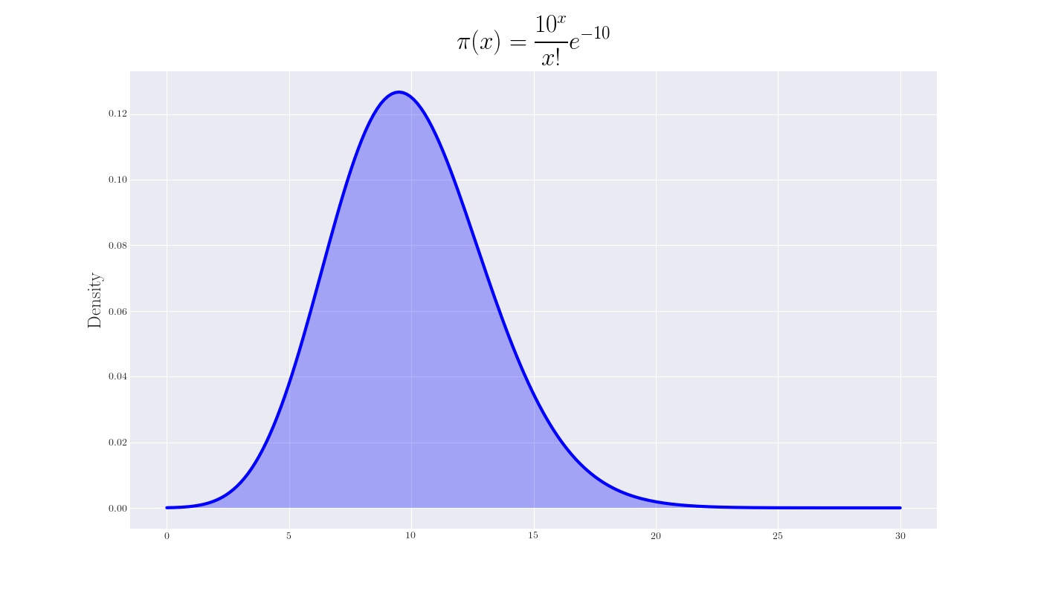
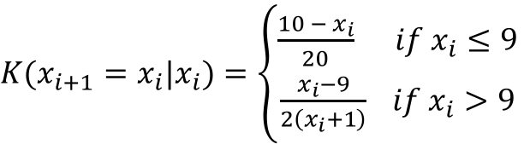
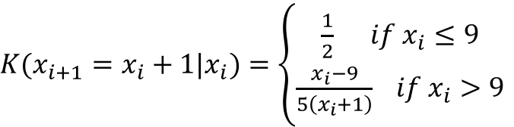
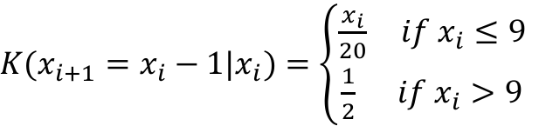
Markov Chain Monte Carlo
Markov chain on the real line
$K(x_{i+1}=x_{i}−1|x_{i})=\left\{\begin{aligned}\frac{x_{i}}{20} if x_{i}≤9 \\ \frac{1}{2} if x_{i}>9\end{aligned}\right.$
$K(x_{i+1}=x_{i}|x_{i})=\left\{\begin{aligned}\frac{{10 − x}_{i}}{20} if x_{i}≤9 \\ \frac{x_{i}−9}{2\left(x_{i}+1\right)} if x_{i}>9\end{aligned}\right.$
$K(x_{i+1}=x_{i}+1|x_{i})=\left\{\begin{aligned}\frac{1}{2} if x_{i}≤9 \\ \frac{x_{i}−9}{5\left(x_{i}+1\right)} if x_{i}>9\end{aligned}\right.$

Slide 8
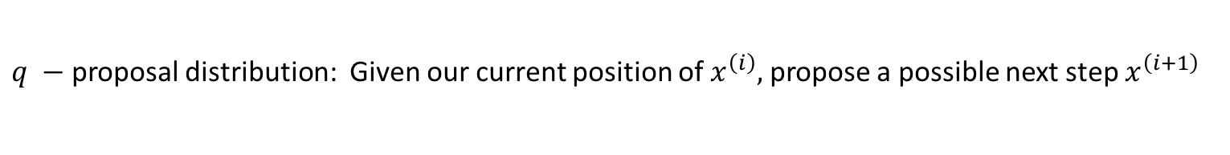
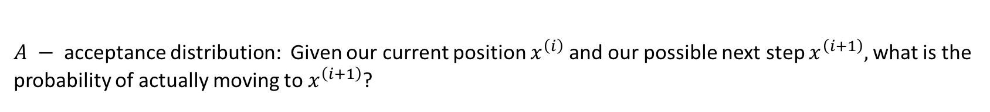
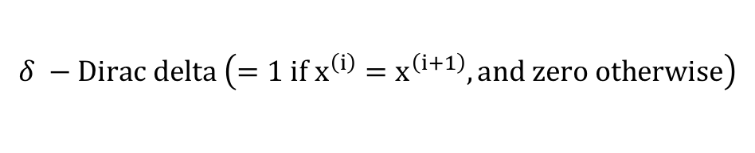
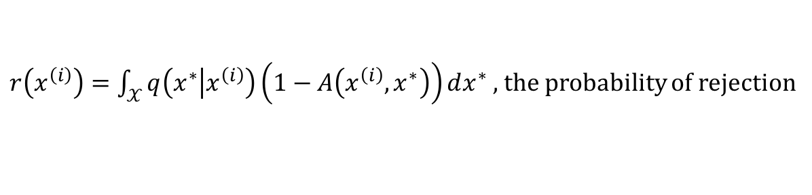
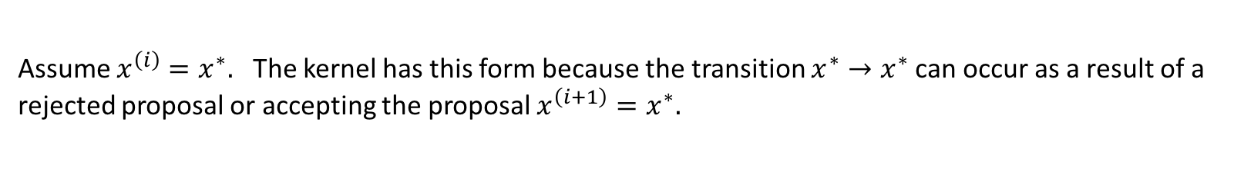
Metropolis-Hastings Kernel
Goal: Construct a Markov Chain whose stable distribution is equal to target distribution
$$K_{MH}\left(x^{\left(i+1\right)} | x^{\left(i\right)}\right)=q\left(x^{\left(i+1\right)} | x^{\left(i\right)}\right)A\left(x^{\left(i\right)},x^{\left(i+1\right)}\right)+δ_{x^{\left(i\right)}}\left(x^{\left(i+1\right)}\right)r\left(x^{\left(i\right)}\right)$$
$q −$proposal distribution: Given our current position of $x^{\left(i\right)},$ propose a possible next step $x^{\left(i+1\right)}$
$A −$acceptance distribution: Given our current position $x^{\left(i\right)}$ and our possible next step $x^{\left(i+1\right)},$ what is the
probability of actually moving to $x^{\left(i+1\right)}$?
$$δ −Dirac delta \left(=1 if x^{\left(i\right)}=x^{\left(i+1\right)}, and zero otherwise\right)$$
$r\left(x^{\left(i\right)}\right)=\int_{𝒳}{q\left(x^{∗} | x^{\left(i\right)}\right)\left(1−A\left(x^{\left(i\right)},x^{∗}\right)\right)dx^{∗} , }$the probability of rejection
Assume $x^{\left(i\right)}=x^{∗}.$ The kernel has this form because the transition $x^{∗}→x^{∗}$can occur as a result of a
rejected proposal or accepting the proposal $x^{\left(i+1\right)}=x^{∗}.$

Slide 9
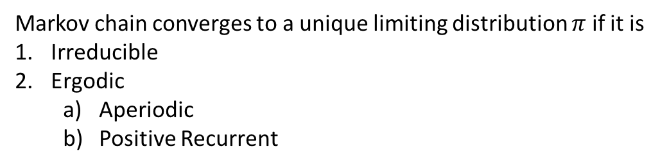
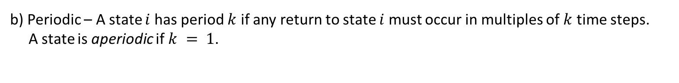
Convergence Criteria
Goal: Construct a Markov Chain whose stable distribution is equal to target distribution
Markov chain converges to a unique limiting distribution $π$ if it is
Irreducible
Ergodic
Aperiodic
Positive Recurrent
b) Periodic – A state $i$ has period $k$ if any return to state $i$ must occur in multiples of $k$ time steps.
A state is aperiodic if $k = 1$.
a) Positive Recurrent State: State $i$ is positive recurrent if the expected return time to state $i$ is finite.
A Markov chain is positive recurrent if all of its states are positive recurrent.
We can guarantee that the Markov chain converges to the target distribution if the kernel $K_{MH}$ satisfies
the detailed balance equation

Slide 10
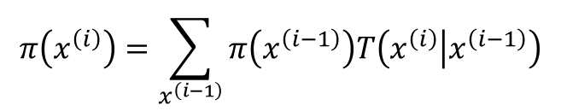
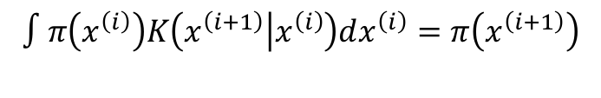
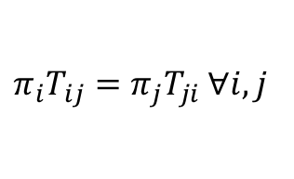
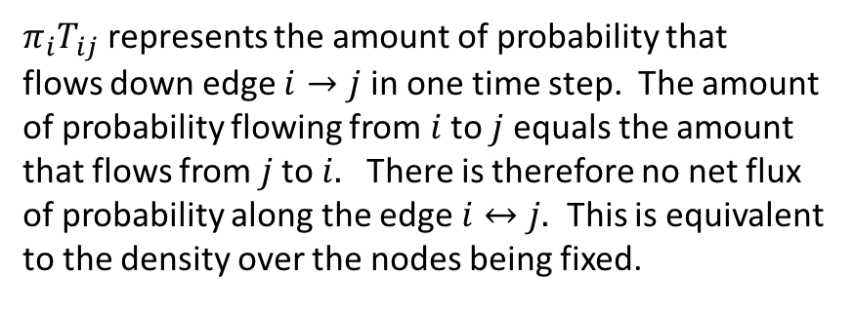
Convergence Criteria
Balance Condition:
Intuition: this condition implies that if we generate an ensemble of samples from the target distribution and applied the transition, then we would get a new ensemble that was still distributed according to the target distribution
$$π\left(x^{\left(i\right)}\right)K_{MH}\left(x^{\left(i+1\right)} | x^{\left(i\right)}\right)=π\left(x^{\left(i+1\right)}\right)K_{MH}\left(x^{\left(i\right)} | x^{\left(i+1\right)}\right)$$
Discrete detailed balance condition:
$$π\left(x^{\left(i\right)}\right)T\left(x^{\left(i−1\right)} | x^{\left(i\right)}\right)=π\left(x^{\left(i−1\right)}\right)T\left(x^{\left(i\right)} | x^{\left(i−1\right)}\right)$$
$π_{i}T_{ij}=π_{j}T_{ji}$ $∀i,j$
Summing both sides yields
$π_{i}T_{ij}$ represents the amount of probability that
flows down edge $i→j$ in one time step. The amount
of probability flowing from $i$ to $j$equals the amount
that flows from $j$ to $i.$ There is therefore no net flux
of probability along the edge $i↔j.$ This is equivalent
to the density over the nodes being fixed.
$$π\left(x^{\left(i\right)}\right)=\sum_{x^{\left(i−1\right)}}{π\left(x^{\left(i−1\right)}\right)T\left(x^{\left(i\right)} | x^{\left(i−1\right)}\right)}$$
Continuous version:
$$∫π\left(x^{\left(i\right)}\right)K\left(x^{\left(i+1\right)} | x^{\left(i\right)}\right)dx^{\left(i\right)}=π\left(x^{\left(i+1\right)}\right)$$

Slide 11
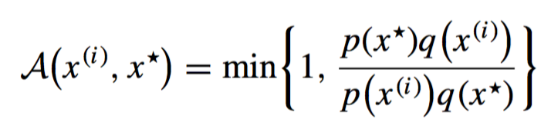
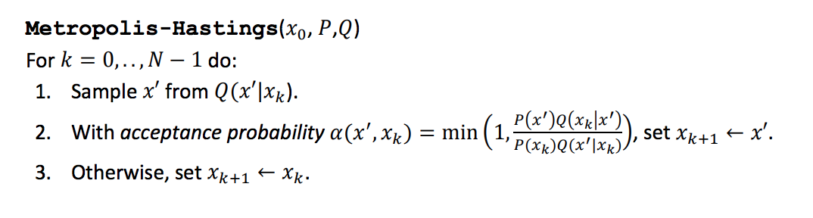
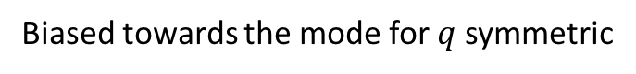
MCMC - Metropolis Hastings
Balance Condition Holds
$$p\left(x^{\left(i\right)}\right)K_{MH}\left(x^{\left(i+1\right)} | x^{\left(i\right)}\right)=p\left(x^{\left(i+1\right)}\right)K_{MH}\left(x^{\left(i\right)} | x^{\left(i+1\right)}\right)$$
for kernel
$$K_{MH}\left(x^{\left(i+1\right)} | x^{\left(i\right)}\right)=q\left(x^{\left(i+1\right)} | x^{\left(i\right)}\right)A\left(x^{\left(i\right)},x^{\left(i+1\right)}\right)+δ_{x^{\left(i\right)}}\left(x^{\left(i+1\right)}\right)r\left(x^{\left(i\right)}\right)$$
by setting
Biased towards the mode for $q$ symmetric
Algorithm

Slide 12
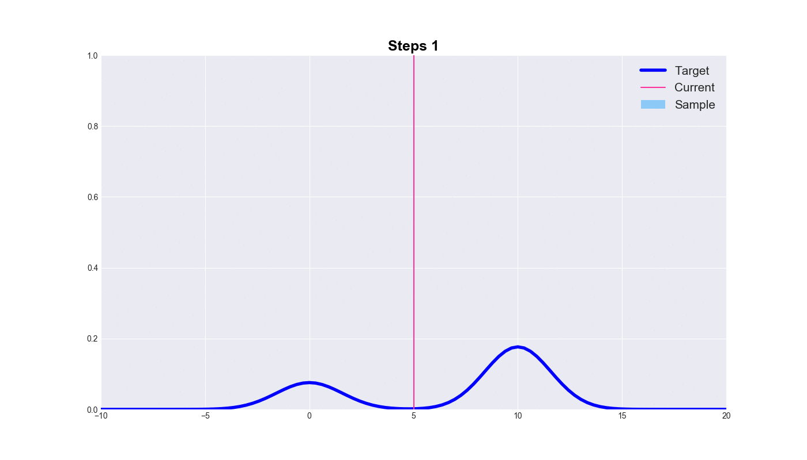
Metropolis - Hastings

Slide 13
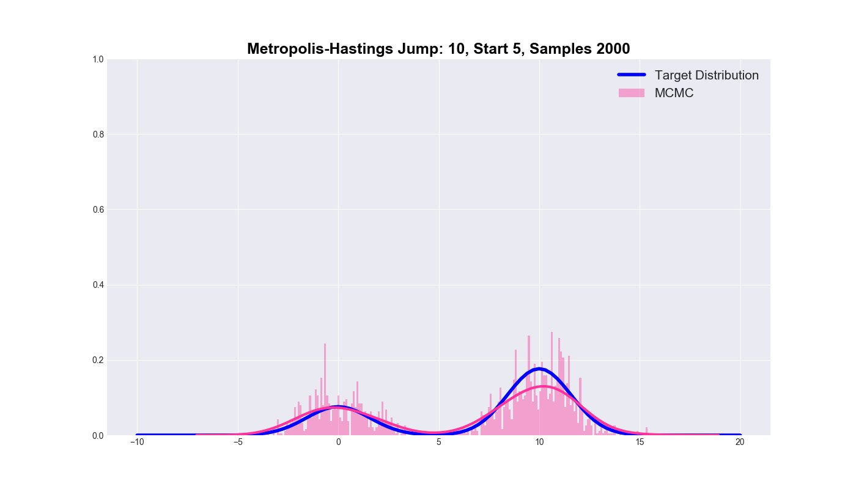
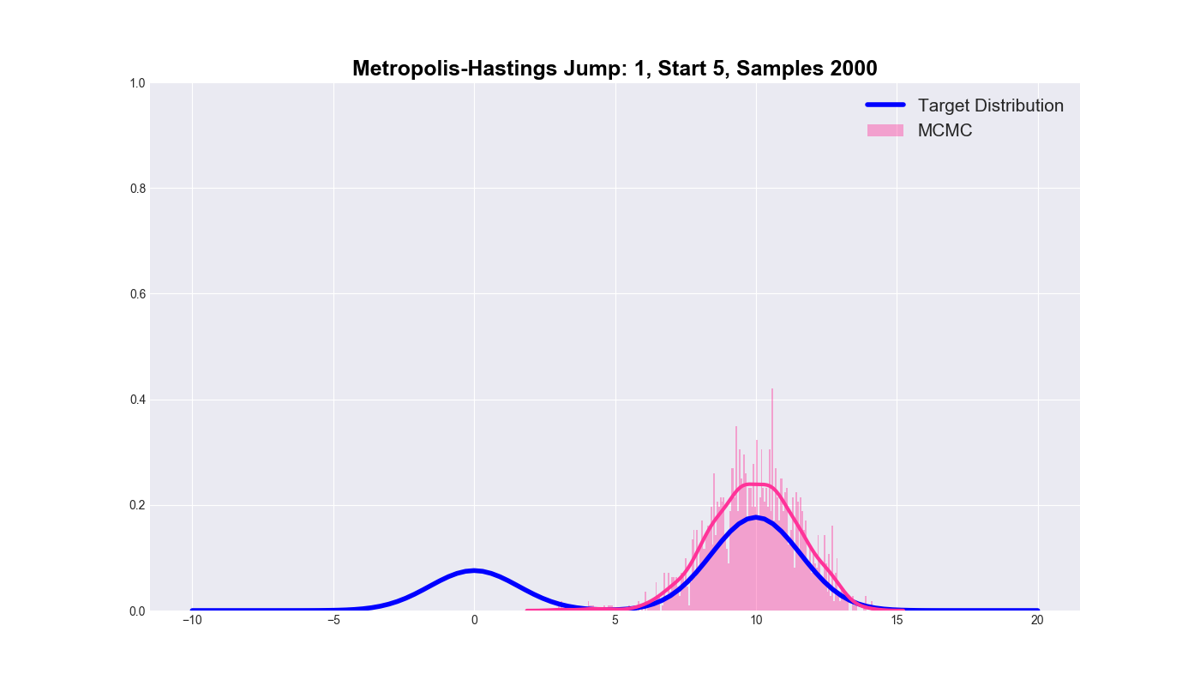
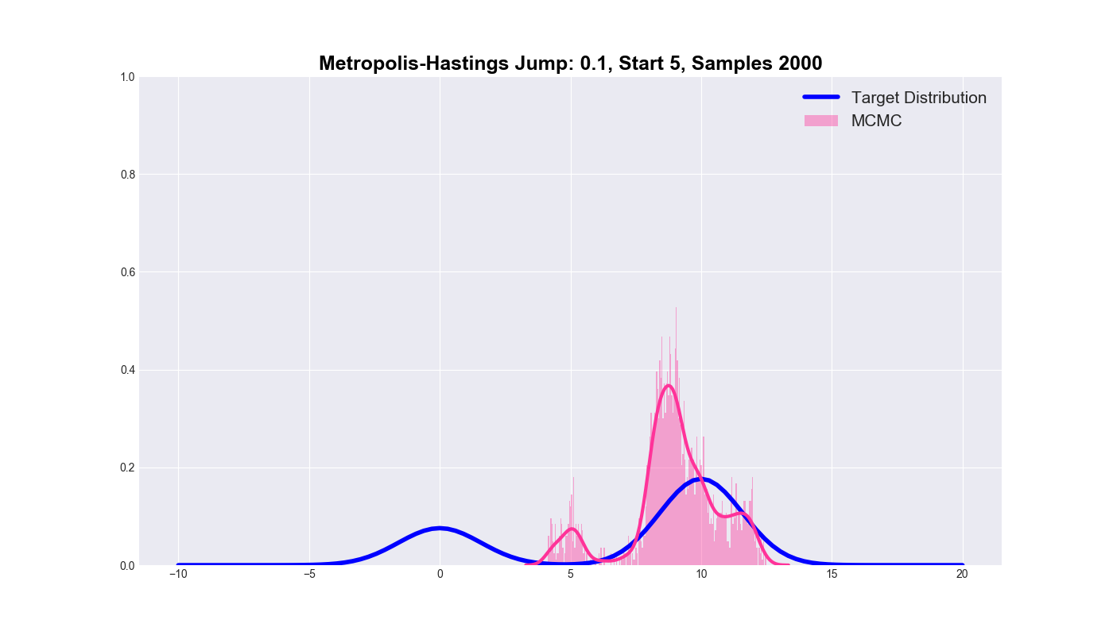
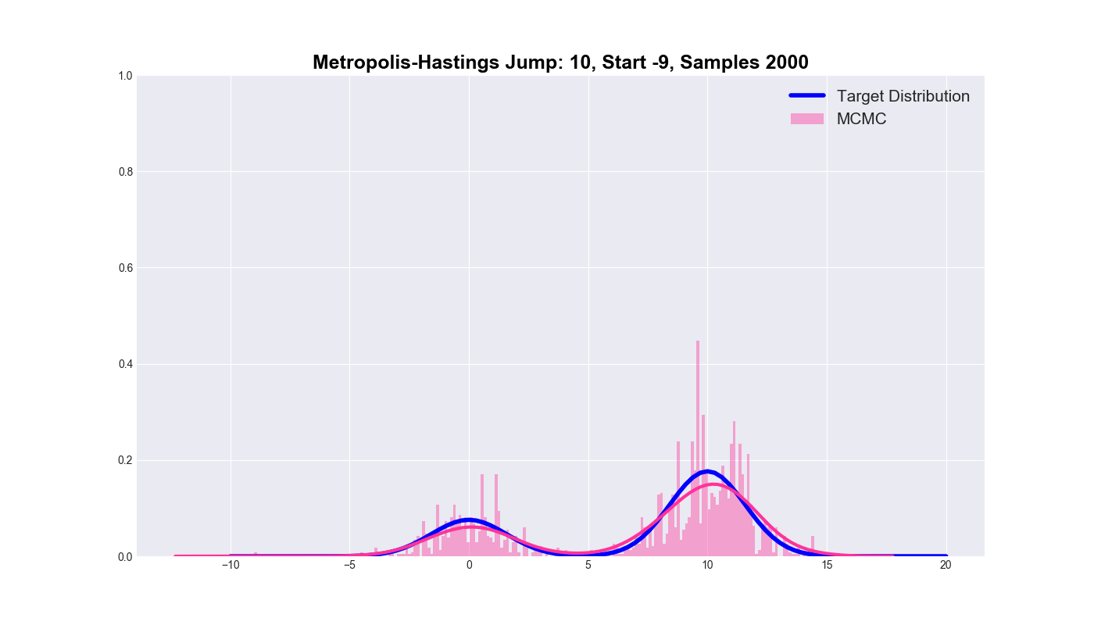
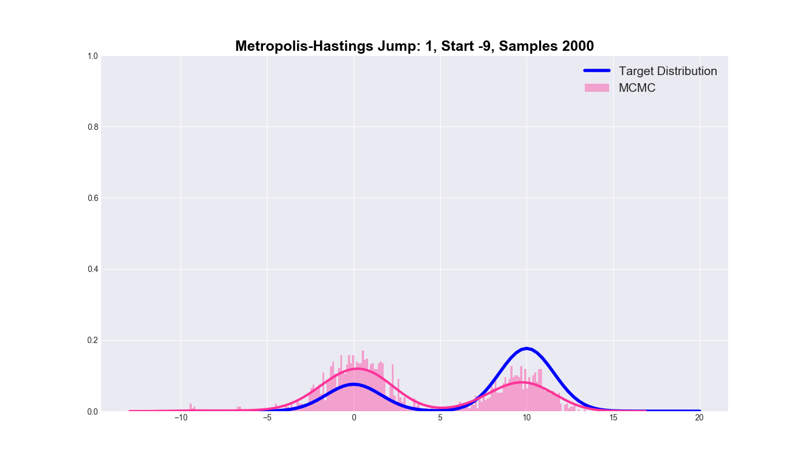

Metropolis – Hastings : Parameter Grid

Slide 14
MCMC - Metropolis Hastings in High Dim
Algorithms like MH tend to fail in high dimensions.
Why?
Because $q\left(x^{\left(i+1\right)} | x^{\left(i\right)}\right)$ for $q$ naïve mistakes density for mass

Slide 15








Measure Theory – Density vs Mass
Let $X$ be a set and $Σ$ a $σ−algebra$ over $X$. A function $m:Σ→ℝ∪\{+∞,−∞\}$ is a measure if it satisfies the following:
Non-negativity: For all $E$ in $Σ:$ $m\left(E\right)≥0$
Null empty set: $m\left(∅\right)=0$
Countable additivity:$m\left(\bigcup_{k=1}^{∞}{E_{k}}\right)=\sum_{k=1}^{∞}{m\left(E_{k}\right)}$
What is the size of the interval $[a,b]$?
Lebesgue Measure:
$m_{ℒ}\left(\left[a,b\right]\right)=b−a$
Dirac Measure:
$δ_{c}\left(\left[a,b\right]\right)=1$
$φ −$defined Measure:
$m_{φ}\left(\left[a,b\right]\right)=\int_{\left[a,b\right]}{dφ}=\int_{a}^{b}{φdx}$
$P$defined by a density $φ:$ $P\left(\left[a,b\right]\right)=\int_{\left[a,b\right]}{dφ}$
$$φ$$
$$a$$
$$c$$
$$b$$
measure
Example:
$$p\left(\tilde{x} | X\right)=\int_{θ}{p\left(\tilde{x} | θ,X\right)p\left(θ | X,α\right)dθ}=𝔼_{p\left(θ | X,α\right)}[p\left(\tilde{x} | θ,X\right)]$$

Slide 16



Volumes in High Dimensions
Distribution of volume as a function of dimension:
$3^{D} −1$neighboring partitions in $D −$dimensional
space
In terms of concentric spherical shells

Slide 17





The Typical Set: Example
$$d=1: 99.73\% of mass in S(0.1,3)$$
$$d=10: 99.44\% of mass in S(1,5)$$
$$d=100: 99.53\% of mass in S(8,12)$$
$$d=1000: 99.00\% of mass in S(30,34)$$

Slide 18








Integration over the Typical Set
$$π$$
$$f$$
Low Probability Mass – High density, Low measure
High Probability Mass – Medium density, Medium measure
Low Probability Mass – Low density, High measure
$$Ω$$
Partition the entire sample space $Ω$
$$f\left(q_{1}\right)dπ_{1}$$
$$f\left(q_{2}\right)dπ_{2}$$
$$f\left(q_{3}\right)dπ_{3}$$
$$\int_{Ω}{fdπ \sim \int{fdπ} \sim \frac{1}{n}\sum_{q\sim }{f\left(q\right)}}$$
Rectangle Area = $f\left(q_{2}\right)dπ_{2}≫f\left(q_{1}\right)dπ_{1},f\left(q_{3}\right)dπ_{3}$

Slide 19






The Typical Set
$dq=$ measure: curve expresses Lebesgue measure of
$\{q^{∗} s.t. \left|q^{∗}−q_{mode}\right|<q\}$ as a function of distance from
the mode, i.e., the volume contained the $n−$ sphere of
radius $\left|q−q_{Mode}\right|.$
$π\left(q\right)=$density: curve expresses probability density defined
by $π$ as a function of distance from the mode
$π\left(q\right)dq=$mass: curve expresses the probability mass as
a function of distance from the mode
Note: $π\left(q\right)dq=dπ(q):$measure defined by the density $π$
as a function of distance from the mode
Naïve intuition – simply use calculus to find the modes of the density and use density-based MCMC
with small step size to explore each mode independently.
Better Intuition$−$ No need to integrate in regions where $dπ(q)= π\left(q\right)dq≪0$

Slide 20
Integration over the Typical Set
Question: How can we take advantage of the geometry of our
distribution so that our Markov Chain spends the vast majority
of its time sampling the typical set?
Answer: Hamiltonian Monte Carlo

Slide 21






Hamiltonian Mechanics – Phase Space
$$H=K+V$$
$K=$Kinetic Energy
$$V+K$$
$$H$$
$V=Potential$ Energy
Black – Kinetic Energy
Red – Potential Energy
Blue – Total Energy (constant)

Slide 22

Hamiltonian Monte Carlo
Hamilton’s Equations:
Trajectories obtained by integrating this vector field are energy preserving – Markov chain proposals
sit at the ends of these trajectories.

Slide 23



Hamiltonian Monte Carlo – Hamilton’s Eqns
Hamilton’s Equations:
Idea – describe the dynamics of a system by considering the total energy of the system in terms
of canonical coordinates in phase space $(q,p): q$ – spatial coordinates, $p$ – momentum coordinates
Time evolution of the system described by Hamilton’s Equations:
$$\frac{dq}{dt}= +\frac{∂H}{∂p}=\frac{∂K}{∂p}$$
$$\frac{dp}{dt}=−\frac{∂H}{∂q}=−\frac{∂K}{∂q} −\frac{∂V}{∂q}$$
Trajectories obtained by integrating this vector field are energy preserving – Markov chain proposals
are sit at the ends of these trajectories.

Slide 24






Hamiltonian Monte Carlo – Vector Fields
Typical Set
Desired Markov Step Through Typical Set
Step based solely on density gradient
Preferred vector field
Phase (position,momentum) space
Energy level sets in phase space

Slide 25







Hamiltonian Monte Carlo – Energies
Kinetic energy as a function of momentum in one dimension takes the form $K\left(p\right)=\frac{p^{2}}{2m}$
In higher dimensions $K\left(q,p\right)$ should look like quadratic form in $p: K\sim p^{T}A p$
Is there a matrix $A$which encodes the geometry of the distribution?
Set the kinetic energy to $K\left(q,p\right)=\frac{1}{2}p^{T}M^{−1}p+\log\left|M\right|+const$
for $M^{−1}= 𝔼\left[\left(q−μ\right){\left(q−μ\right)}^{T}\right]$
Equivalently,
$$e^{−K\left(q,p\right)}∝N\left(p | 0,M\right)$$
Potential energy should be a function of the gradient of the density
Following the skateboarder analogy, we should set the potential energy
to $V\left(q\right)=−\log{π\left(q\right)}$

Slide 26




Hamiltonian Monte Carlo – Momentum
Intuition – when traveling along trajectories in projected space we have two families of
states:
Small Changes in Momentum Space
Small Changes in Momentum Space
$dist\left(p_{i}\left(t\right),p_{i}\left(t+Δt\right)\right)$small
$dist\left(p_{i}\left(t\right),p_{i}\left(t+Δt\right)\right)$large
Large Changes in Position Space
Large Changes in Position Space
$dist\left(q_{i}\left(t\right),q_{i}\left(t+Δt\right)\right)$large
$dist\left(q_{i}\left(t\right),q_{i}\left(t+Δt\right)\right)$ small
Upshot: The metric in position space should be dual to the metric in momentum space.
Position Space Metric: $dist\left(q,q^{′}\right)={\left(q−q^{′}\right)}^{T}M(q−q^{′})$
Momentum Space Metric: $dist\left(p,p^{′}\right)={\left(p−p^{′}\right)}^{T}M^{−1}(p−p^{′})$

Slide 27







Hamiltonian Monte Carlo – Canonical Dist
Explanation as to why it makes sense to set –log(p(x)) equal to potential energy
Lift the target distribution $π(q)$ to a distribution over $π_{Q,P}\left(q,p\right)=π_{P|Q}\left(p | q\right)π_{Q}\left(q\right)$ phase space such that
$$π\left(q\right)= ∫π_{Q,P}\left(q,p\right)dp=∫π_{P|Q}\left(p | q\right)π_{P}\left(p\right)dp$$
Given a closed system with energy $E$, we can associate a probability distribution $P$called the canonical distribution
$$P=\frac{1}{Z}\exp\left(−\frac{E}{T}\right)$$
which assigns a probability to each possible state of the system – this is exactly what we want, i.e., a way of
constructing trajectories through phase space by via sampling
In our case, the energy $E$is given by the Hamiltonian $H\left(q,p\right)=K\left(q,p\right)+V\left(q\right)$
This yields $e^{−H\left(q,p\right)}=e^{−K\left(q,p\right)}e^{−V\left(q\right)}=π\left(p | q\right)π\left(q\right)$
and we should set
$π\left(p | q\right)≔e^{−K\left(q,p\right)}$or $K\left(q,p\right)=−\log{π\left(p | q\right)}$
$($Prev Slide:$π\left(p | q\right)=N(p|0,M)$)
$π\left(q\right)≔e^{−V\left(q\right)}$or $V\left(q\right)=−\log{π\left(q\right)}$

Slide 28

Hamiltonian Monte Carlo – Trajectories
Outline Algorithm at High Level:
Choose a point in parameter space $q_{0}$
Randomly sample from the momentum distribution $p_{0} \sim π(p|q)$
Run the energy-preserving trajectory forward to $\left(q^{∗},p^{∗}\right)$
Project $\left(q^{∗},p^{∗}\right)$ to $q^{∗}$
Check acceptance
Repeat 2 – 5

Slide 29













Hamiltonian Monte Carlo – Leap Frog
How do we integrate this vector field to obtain energy-preserving trajectories through phase space?
Example: Sample a bivariate normal
$K\left(q,p\right)=−\log{π\left(p | q\right)=}−\log{N(p|0,1)}$)
$$V\left(q\right)=\frac{1}{2}q^{T}Σ^{−1}q$$
$$\frac{∂V}{∂q}=Σ^{−1}q$$
$$\frac{∂K}{∂p}=p$$
$$Σ^{−1}$$
$$Σ^{−1}$$

Slide 30

Hamiltonian Monte Carlo – The Algorithm
The Algorithm:
set $t=0$
generate an initial position state $x^{\left(0\right)} \sim π$
repeat until $t=M$
set $t=t+1$
sample a new initial momentum variable from the canonical momentum distribution $p_{0} \sim P(p)$
set $x_{0}=x^{\left(t−1\right)}$
run Leap Frog algorithm starting at $[x_{0},p_{0}]$ for $L$steps and step size $δ$ to obtain proposed states $x^{∗}$and $p^{∗}$
calculate the Metropolis acceptance probability $α=\min\left(1,\exp\left(−U\left(x^{∗}\right)+U\left(x_{0}\right)−K\left(p^{∗}\right)+K\left(p_{0}\right)\right)\right)$
draw a random number $u$from $Unif(0,1)$
if $u≤α$accept the proposed state position $x^{∗}$and set the next state in the Markov chain $x^{\left(t\right)}=x^{∗}$
else set $x^{\left(t\right)}=x^{\left(t−1\right)}$

Slide 31
Hamiltonian Monte Carlo – The Movie
https://chi-feng.github.io/mcmc-demo/app.html#HamiltonianMC,banana

Slide 32
References
https://stats.stackexchange.com/questions/261796/relationship-between-hessian-matrix-and-covariance-matrix
https://arxiv.org/abs/1206.1901
https://theclevermachine.wordpress.com/2012/11/18/mcmc-hamiltonian-monte-carlo-a-k-a-hybrid-monte-carlo/
http://khalibartan.github.io/MCMC-Hamiltonian-Monte-Carlo-and-No-U-Turn-Sampler/
https://en.wikipedia.org/wiki/Lagrangian_mechanics
https://www1.maths.leeds.ac.uk/~voss/projects/2011-RJMCMC/AiJialin.pdf
https://stats.stackexchange.com/questions/271385/mcmc-metropolis-hasting-formal-derivation-of-detailed-balance
https://www.math.wustl.edu/~sawyer/hmhandouts/MetropHastingsEtc.pdf
http://dept.stat.lsa.umich.edu/~kshedden/Courses/Stat606/Notes/mcmc.pdf
https://arxiv.org/pdf/1701.02434.pdf
https://en.wikipedia.org/wiki/Examples_of_Markov_chains
https://en.wikipedia.org/wiki/Markov_chain#Stationary_distribution
https://cims.nyu.edu/~holmes/teaching/asa17/handout-Lecture3_2017.pdf
https://en.wikipedia.org/wiki/Multivariate_normal_distribution
https://en.wikipedia.org/wiki/Riemann%E2%80%93Stieltjes_integral
https://en.wikipedia.org/wiki/Measure_(mathematics)
https://engineering.purdue.edu/~ipollak/ece302/SPRING12/notes/26_Limit_Theorems_1_WLLN_packed.pdf
https://en.wikipedia.org/wiki/Law_of_large_numbers
http://www.ics.uci.edu/~johnsong/papers/Chib%20and%20Greenberg%20-%20Understanding%20the%20Metropolis-Hastings%20Algorithm.pdf

Slide 33

Histograms via Random Walks

Slide 34

MCMC - Metropolis Hastings

Slide 35

Distribution Building via Random Walks
Random Walker – start with a sampling algorithm and compute a density $f$ of the distribution of observations
Our Goal: Reverse this – Create a random walker in such a way as the resulting density matches the prescribed
function up to multiplication by a scalar

Slide 36





Distribution Building via Random Walks
Example: Intuit a Markov method of sampling from histogram
Consider a normalized histogram $f$ defined over $Ω=\{0,1,…,7\}$
Let $S_{N}$ denote our current position in
$\left\{x_{i}\right\}≔\left\{0,1,…,7\right\}.$Need a procedure for choosing $S_{N+1}.$
Proposal:
$prop_{i} \sim U\left(x_{1},x_{2},…, x_{i−1},x_{i+1},…,x_{N}\right)$
Acceptance:
$$P\left(accept x_{i} | x_{j}\right)=\min\left(\frac{f\left(x_{i}\right)}{f\left(x_{j}\right)},1\right)$$
Need to define a random walk procedure in such a way that the histogram of counts of steps on elements of
$Ω$ matches $f$

Slide 37

Distribution Building via Random Walks

Slide 38


The Typical Set: Example
MV Gaussian $μ=0, Σ=I_{n}$

